Slide 1

Mid-Point Presentation Group 22
Shane Mulrooney
Sean Fulton
Cree Gunning

Slide 2

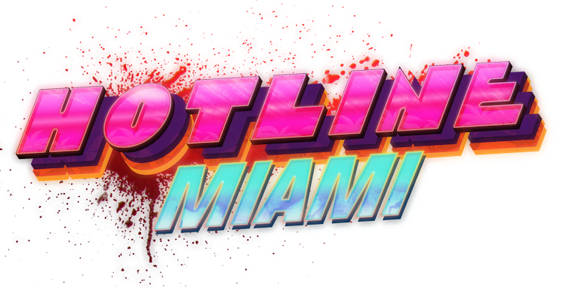
Application Idea (Shane)
Video game application
Borrowed inspiration from multiple games
Call of Duty: Zombies
Hotline Miami
Merged genres to create something unique

Slide 3
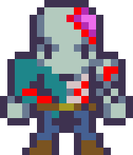

Target Audience (Shane)
For fans of:
Top-down shooter genre
Endless round-based games
Pixel-art styled games

Slide 4
Technologies Used (Cree)

Slide 5
Project Plan (Cree)

Slide 6
Progress So Far (Sean)

Slide 7
Challenges Faced (Sean)
Changed Development Engine: PyGame
Limited Development Range.
Would not achieve the scope of our application.
Creating the Enemy AI, to chase the Player
Initially made Enemies chase any collision Object.
Changed to chase just the Player.

